Slide 1
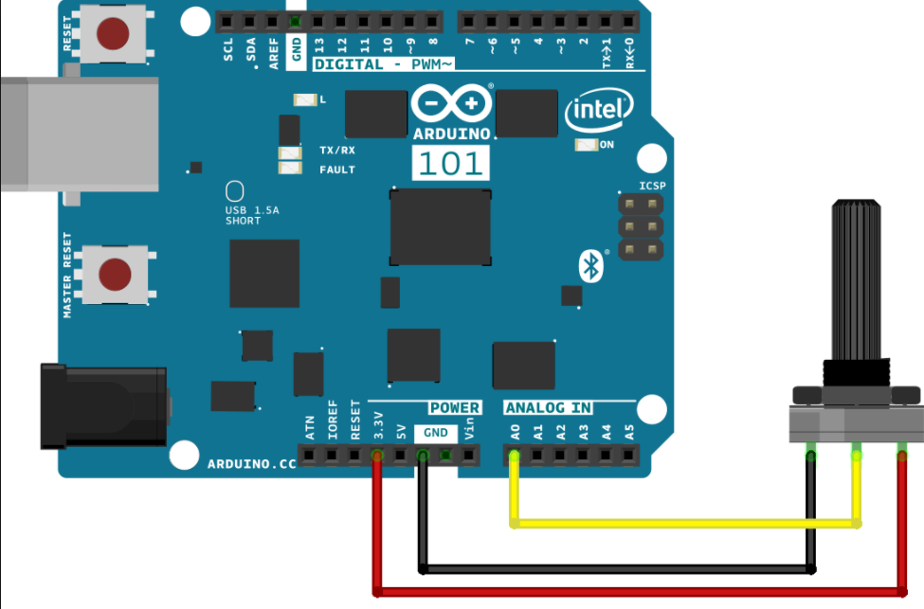
Potentiometer
Variable resistance
analogRead(pin_number);
ADC mode default: 10 bit

Slide 2
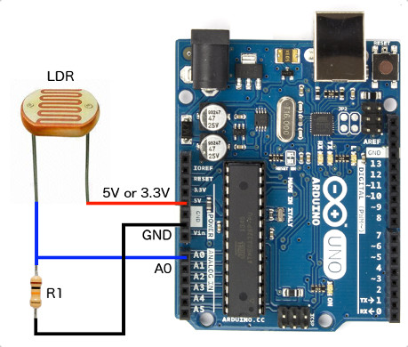
LDR
(light-dependent resistor)
The LDR is a special type of resistor which allows higher voltages to pass through it (low resistance) whenever there is a high intensity of light, and passes a low voltage (high resistance) whenever it is dark.
Analog voltage : directly proportional to the intensity of light
analogRead(pin_number);
ADC mode default: 10 bit

Slide 3
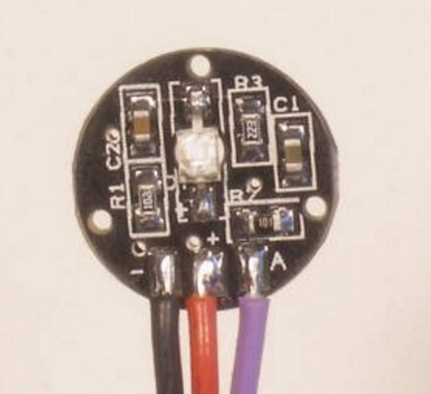
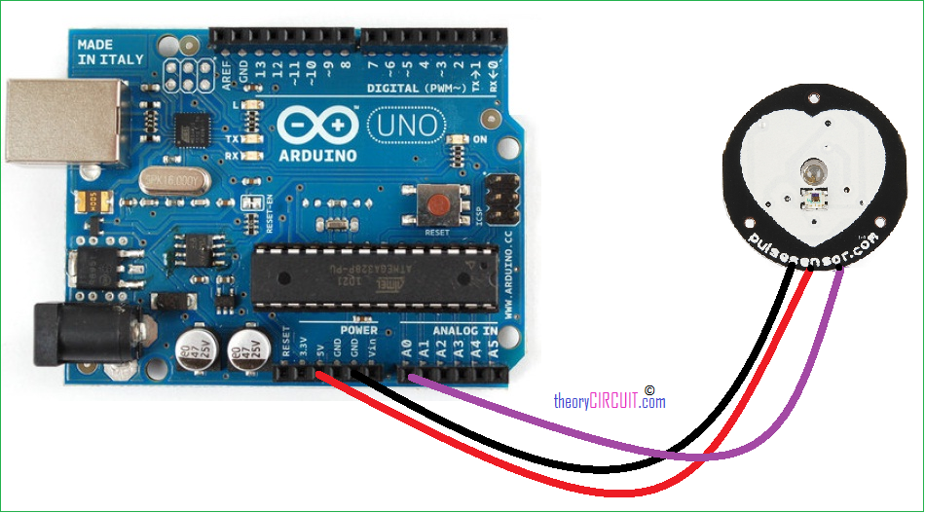
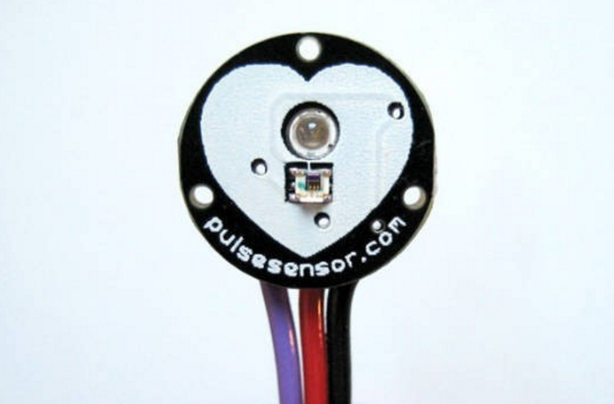
Pulse sensor
3 Wires :
1) VCC
2) GND
3) AnalogOutput
analogRead(pin_number);
ADC mode default: 10 bit

Slide 4
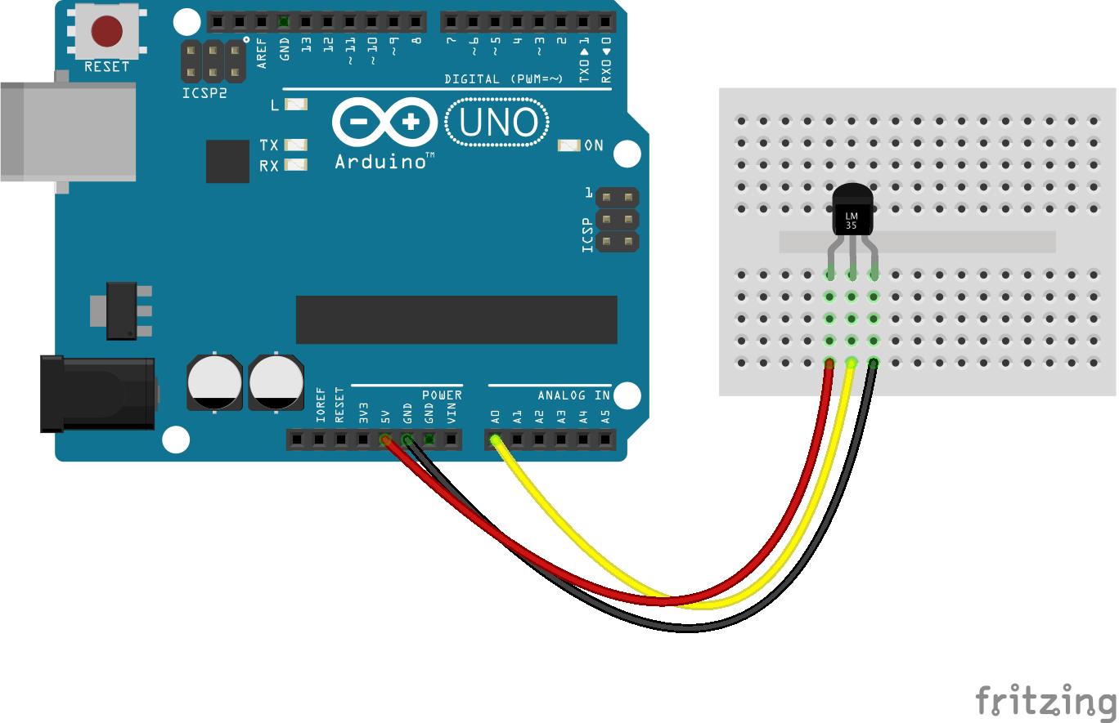
Common Temperature & Humidity sensors
1. LM35 : Temperature sensor
The voltage output of the LM35 increases 10mV per degree Celsius rise in temperature
LM35A: -55 degree Celsius to +150 degree Celsius.
LM35C:-40 degree Celsius to 110 degree Celsius.
LM35D: 0 degree Celsius to 100 degree Celsius.
LM35D : REF_VOLT : 1.1v
analogReference(INTERNAL);
REF_VOLT = 1.1
Temperature = ((analogRead(pin_number)*REF_VOLT/1024.00))*100

Slide 5
analogReference(type)
DEFAULT: the default analog reference of 5 volts (on 5V Arduino boards) or 3.3 volts (on 3.3V Arduino boards)
INTERNAL: an built-in reference, equal to 1.1 volts on the ATmega168 or ATmega328 and 2.56 volts on the ATmega8
(not available on the Arduino Mega)
3. INTERNAL1V1: a built-in 1.1V reference (Arduino Mega only)
4. INTERNAL2V56: a built-in 2.56V reference (Arduino Mega only)
5. EXTERNAL: the voltage applied to the AREF pin (0 to 5V only) is used as the reference.
Warning
Don't use anything less than 0V or more than 5V for external reference voltage on the AREF pin! If you're using an external reference on the AREF pin, you must set the analog reference to EXTERNAL before calling analogRead().Otherwise, you will short together the active reference voltage (internally generated) and the AREF pin, possibly damaging the microcontroller on your Arduino board.

Slide 6
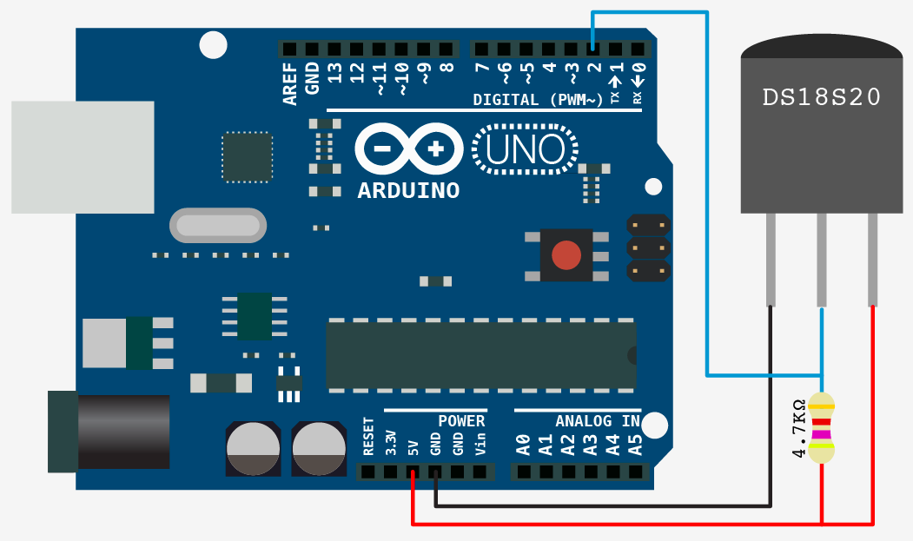
2. DS18B20 :
PROTOCOL : 1WIRE
Pull-up data line (open-drain structure)
Calibrated digital temperature output
1Wire : tolerant of long wires between sensor and Arduino
#include <OneWire.h>
#include <DallasTemperature.h>
OneWire oneWire(pin_number);
DallasTemperature sensors(&oneWire);
sensors.begin();
sensors.requestTemperatures();
sensors.getTempCByIndex(0);// You can have more than one IC on the same bus. // 0 refers to the first IC on the wire
OneWire & DallasTemperature libraries is available on the course page. You should add them to your IDE.

Slide 7
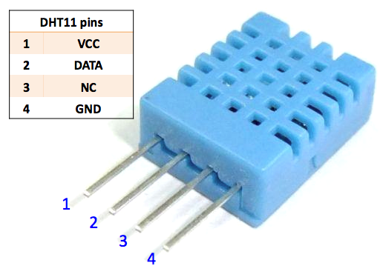
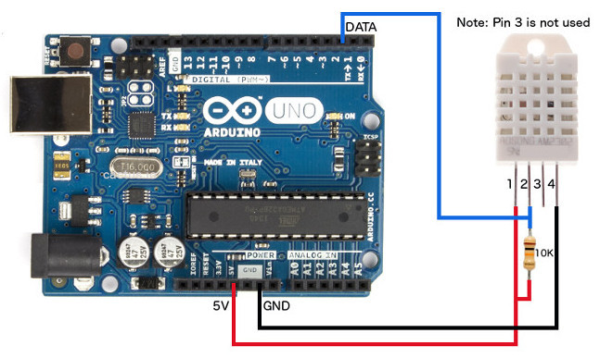
3. DHT 11
PROTOCOL : 1WIRE
Capacitive humidity sensor and a thermistor
Pull-up data line (open-drain structure)
#include <DHT.h>
#include <DHT_U.h>
#include <Adafruit_Sensor.h>
DHT_Unified dht(DHTPIN, DHTTYPE);
dht.begin();
sensors_event_t name_event;
dht.temperature().getEvent(&name_event);
name_event.temperature
dht.humidity().getEvent(&name_event);
name_event.relative_humidity

Slide 8
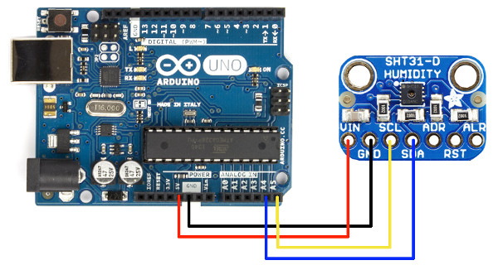
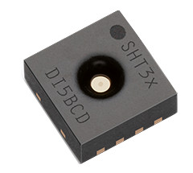
4. SHT 31 (Only a brief introduction)
PROTOCOL : I2C (session 5)
Temperature & Humidity sensor
Pull-up I2C SDA and SCL
Learn more about SHT31
Library is available on the course page

Slide 9
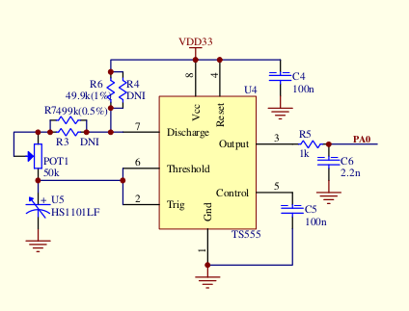
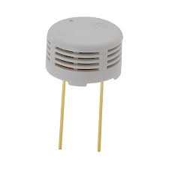
4. HS1101
Capacitive humidity sensor

Slide 10
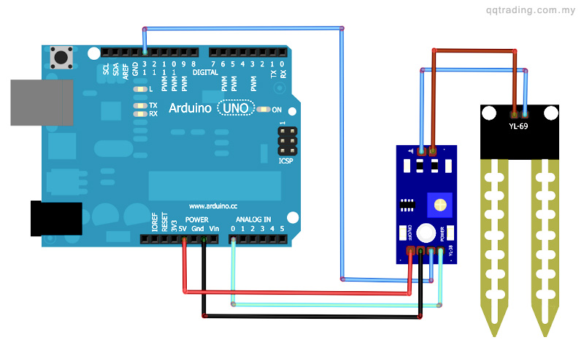
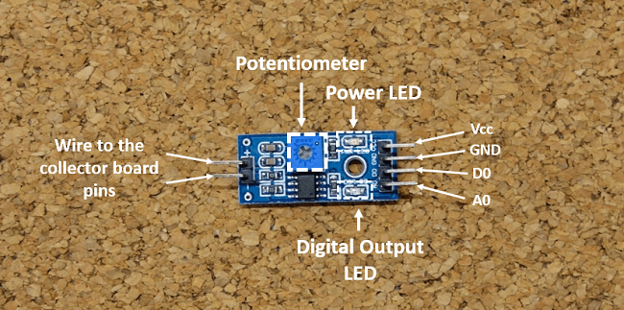
5. YL69
Soil Moisture Sensor
Analog and digital output
automatic watering system
Wet: the output voltage decreases
Dry: the output voltage increases
The sensor has a built-in potentiometer for sensitivity adjustment of the digital output (D0), a power LED and a digital output LED

Slide 11
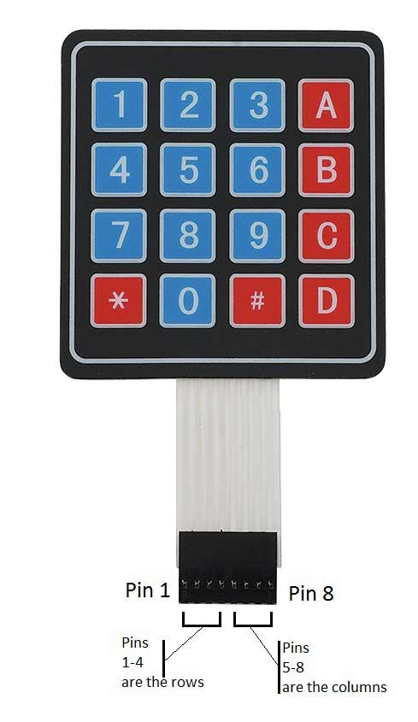
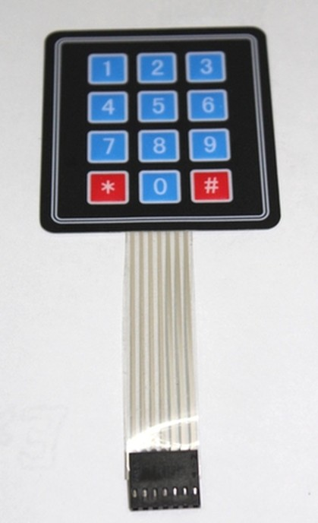
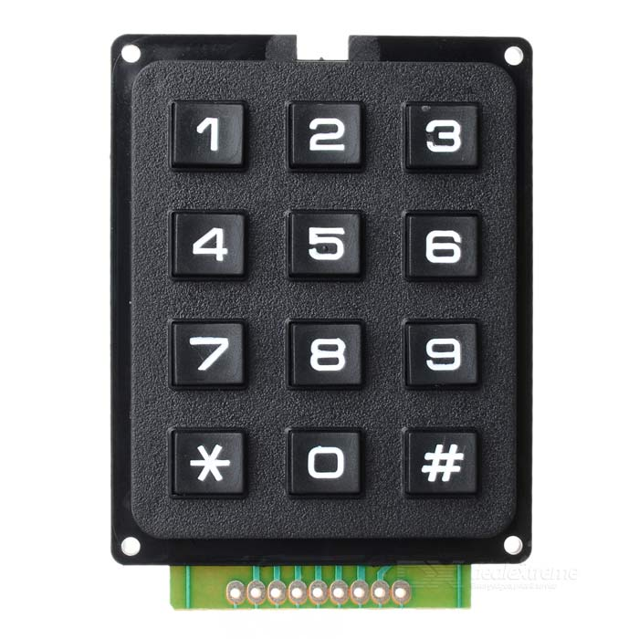
KEYPAD

Slide 12
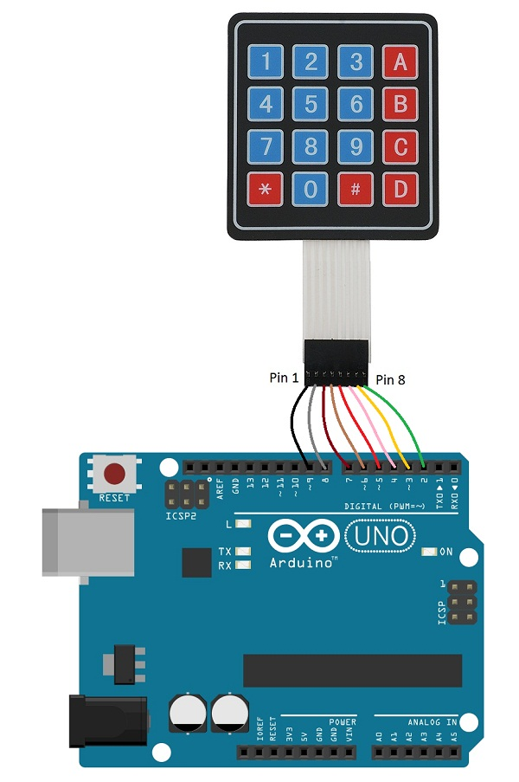
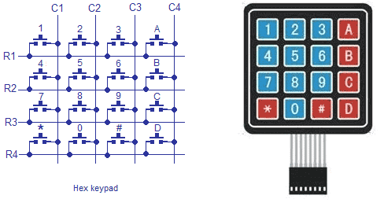
INTRODUCTION
First Step:
Identifying the keypad pins by OHM meter

Slide 13
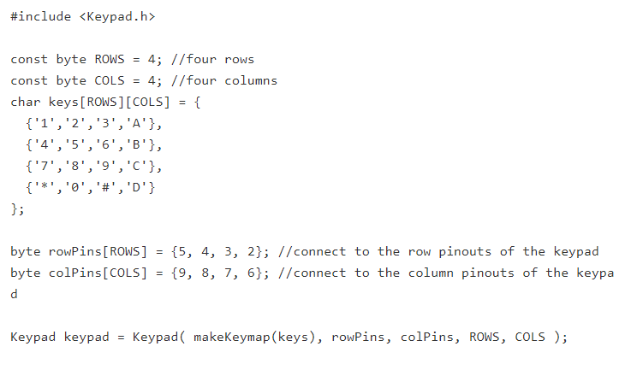
SETTING UP KEYPAD
Instantiates a Keypad object that uses pins 5, 4, 3, 2 as row pins, and 9,8, 7, 6 as column pins.
This keypad has 4 rows and 4 columns, resulting in 16 keys.

Slide 14
KEYPAD FUNCTIONS
void begin(makeKeymap(userKeymap))
Initializes the internal keymap to be equal to userKeymap
char waitForKey()
This function will wait forever until someone presses a key.
Warning: It blocks all other code until a key is pressed. That means no blinking LED's, no LCD screen updates, no nothing with the exception of interrupt routines.
char getKey()
Returns the key that is pressed, if any.
This function is non-blocking.

Slide 15
KEYPAD FUNCTIONS
addEventListener(keypadEvent)
Trigger an event if the keypad is used.
KeyState getState()
Returns the current state of any of the keys.
The four states are IDLE, PRESSED, RELEASED and HOLD.
boolean keyStateChanged()
New in version 2.0: Let's you know when the key has changed from one state to another. For example, instead of just testing for a valid key you can test for when a key was pressed.

Slide 16
KEYPAD FUNCTIONS
setHoldTime(unsigned int time)
Set the amount of milliseconds the user will have to hold a button until the HOLD state is triggered.
setDebounceTime(unsigned int time)
Set the amount of milliseconds the keypad will wait until it accepts a new keypress/keyEvent.
This is the "time delay" debounce method.

Slide 17
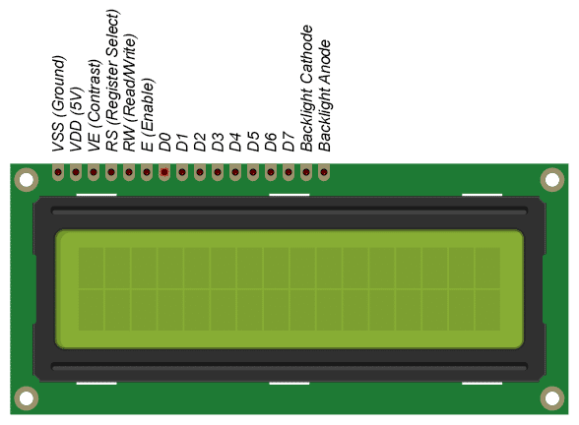
LCD
A register select (RS) pin that controls where in the LCD's memory you're writing data to. You can select either the data register, which holds what goes on the screen, or an instruction register, which is where the LCD's controller looks for instructions on what to do next.
A Read/Write (R/W) pin that selects reading mode or writing mode
An Enable pin that enables writing to the registers

Slide 18
LCD
8 data pins (D0 -D7): The states of these pins (high or low) are the bits that you're writing to a register when you write, or the values you're reading when you read.
NOTE: The LCDs can be controlled in two modes: 4-bit or 8-bit. The 4-bit mode requires seven I/O pins from the Arduino, while the 8-bit mode requires 11 pins. For displaying text on the screen, you can do most everything in 4-bit mode.

Slide 19
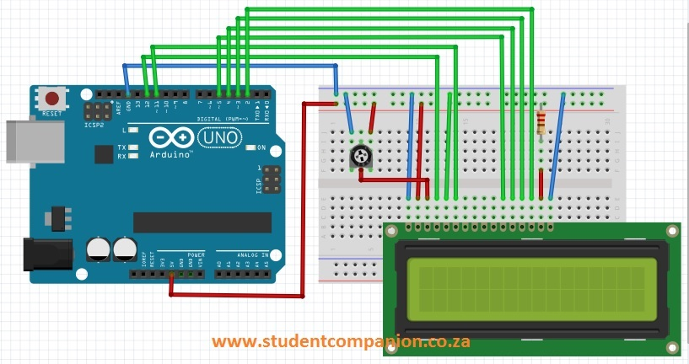
LCD
The resistor in the diagram above sets the backlight brightness. A typical value is 220 Ohms, but other values will work too. Smaller resistors will make the backlight brighter.
The potentiometer is used to adjust the screen contrast. I typically use a 10K Ohm potentiometer, but other values will also work.

Slide 20
LCD FUNCTIONS
LiquidCrystal()
The LiquidCrystal() function sets the pins the Arduino uses to connect to the LCD.
You can use any of the Arduino’s digital pins to control the LCD. Just put the Arduino pin numbers inside the parentheses in this order:
LiquidCrystal(RS, E, D4, D5, D6, D7). RS, E, D4, D5, D6, D7 are the LCD pins.
lcd.begin()
This function sets the dimensions of the LCD. It needs to be placed before any other LiquidCrystal function in the void setup() section of the program. The number of rows and columns are specified as lcd.begin(columns, rows). For a 16×2 LCD, you would use lcd.begin(16, 2), and for a 20×4 LCD you would use lcd.begin(20, 4).

Slide 21
LCD SIMPLE EXAMPLE
#include <LiquidCrystal.h>
LiquidCrystal lcd(12, 11, 5, 4, 3, 2);
void setup() {
lcd.begin(16, 2);
}
void loop() {
lcd.print("hello, world!");
delay(500);
lcd.clear();
delay(500);
}

Slide 22
LCD FUNCTIONS
lcd.print()
This function is used to print text to the LCD. It can be used in the void setup() section or the void loop() section of the program.
NOTE: lcd.print() can print numbers in decimal, binary, hexadecimal, and octal bases. For example:
lcd.print(100, DEC) prints “100”;
lcd.print(100, BIN) prints “1100100”
lcd.print(100, HEX) prints “64”
lcd.print(100, OCT) prints “144”
lcd.clear()
This function clears any text or data already displayed on the LCD.

Slide 23
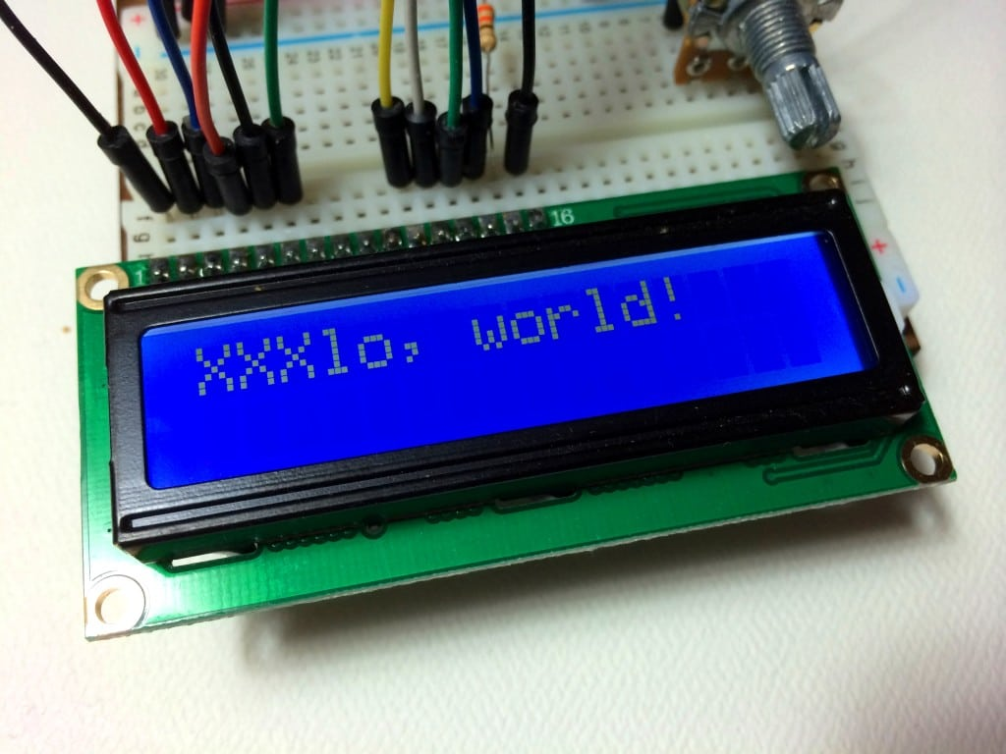
LCD FUNCTIONS
lcd.home()
This function places the cursor in the upper left hand corner of the screen, and prints any subsequent text from that position. For example, this code replaces the first three letters of “hello world!” with X’s:
#include <LiquidCrystal.h>
LiquidCrystal lcd(12, 11, 5, 4, 3, 2);
void setup() {
lcd.begin(16, 2);
lcd.print("hello, world!");
}
void loop() {
lcd.home();
lcd.print("XXX");
}

Slide 24
LCD FUNCTIONS
lcd.setCursor()
This function places the cursor (and any printed text) at any position on the screen. It can be used in the void setup() or void loop() section of your program.
The cursor position is defined with lcd.setCursor(column, row). The column and row coordinates start from zero (0-15 and 0-1 respectively).
lcd.Cursor()
This function creates a visible cursor. The cursor is a horizontal line placed below the next character to be printed to the LCD.
The function lcd.noCursor() turns the cursor off. lcd.cursor() and lcd.noCursor() can be used together in the void loop() section to make a blinking cursor similar to what you see in many text input fields:

Slide 25
LCD FUNCTIONS
lcd.blink()
This function creates a block style cursor that blinks on and off at approximately 500 milliseconds per cycle. Use it in the void loop() section. The function lcd.noBlink() disables the blinking block cursor.
lcd.display()
This function turns on any text or cursors that have been printed to the LCD screen. The function lcd.noDisplay() turns off any text or cursors printed to the LCD, without clearing it from the LCD’s memory.
scrollDisplayRight() scrollDisplayLeft()
autoscroll() rightToLeft()

